Slide 1
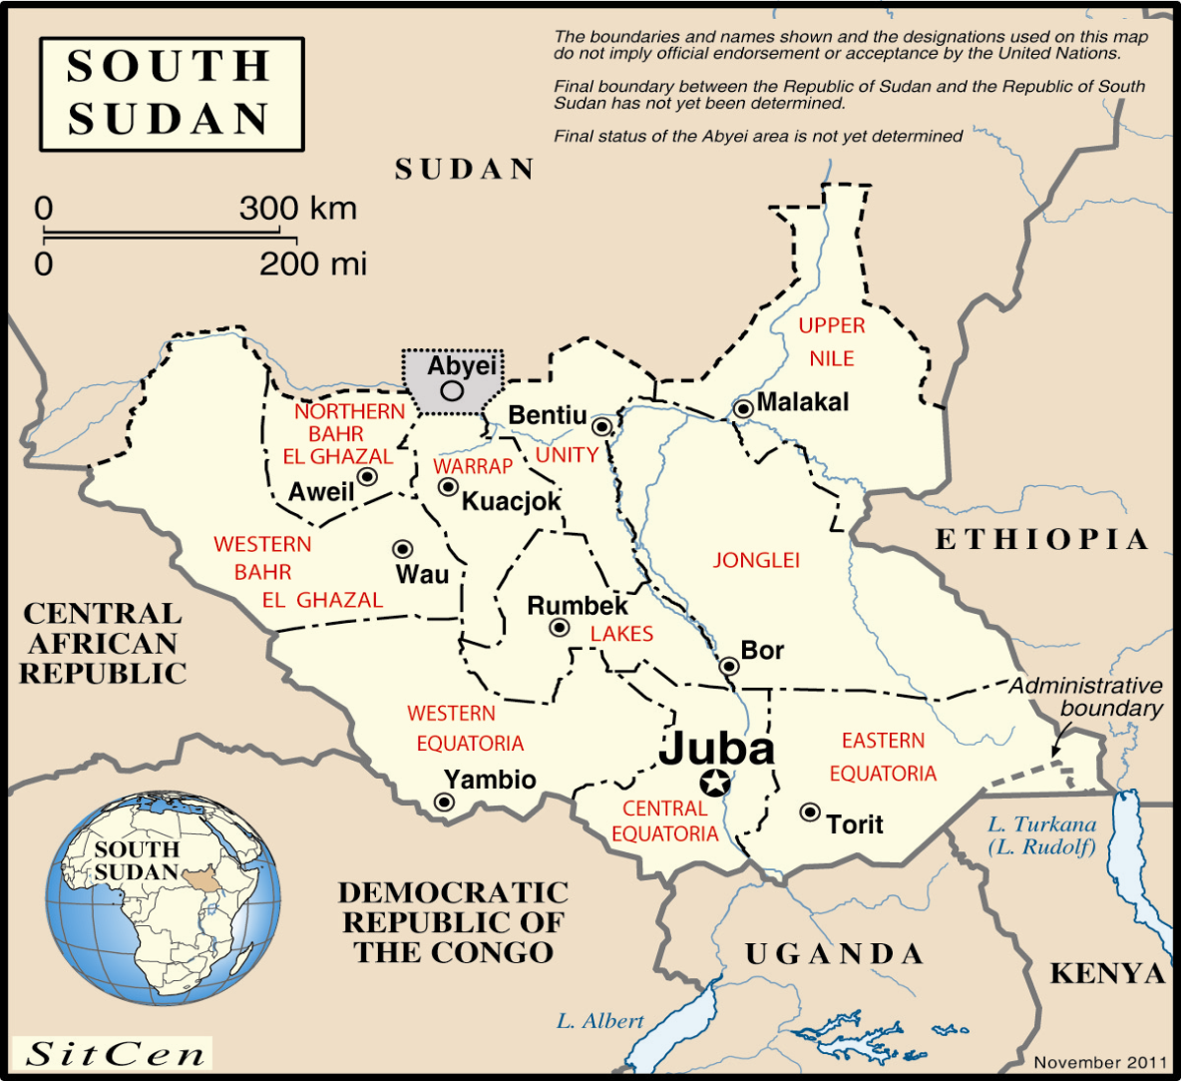
Module 2 Integrated Learning Activity
Map
UN Core Pre-Deployment Training Materials 2017

Slide 2
Module 2: Mandated Tasks of United Nations Peacekeeping Operations
Integrated Learning Activity
Protecting Civilians – “A Shared Responsibility”

Slide 3
Relevance
It is part of your job to implement the mandate and contribute to the success of the mission
You must know how to contribute to all mandated tasks – whether this is your primary/core function or you play a support role
UN Core Pre-Deployment Training Materials 2017

Slide 4
Learning Outcomes
Learners will:
Explain what is meant by “a shared responsibility”
Identify information for assessing vulnerabilities and threats, reporting and response planning
Identify actions for a POC strategy
List actions to take in day-to-day work
UN Core Pre-Deployment Training Materials 2017

Slide 5
Lesson Overview
A Shared Responsibility
What Individual Peacekeeping Personnel Can Do
Situational Awareness
Gathering and Sharing Information
Coordination and Referral
Engaging the Local Community
Take Action – Prevent, Respond, Intervene!
UN Core Pre-Deployment Training Materials 2017

Slide 6
A Shared Responsibility
Implementing the mandate is a shared responsibility
All play a role – civilians, military, police
All work together – directly in lead roles and indirectly in support roles
Regardless of the role, the commitment of all is essential for success
UN Core Pre-Deployment Training Materials 2017

Slide 7
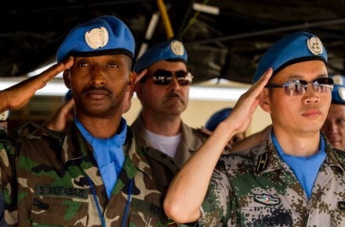
What Individual Peacekeeping Personnel Can Do
Situational Awareness
Gathering and Sharing Information
Coordination and Referral
Engaging the Local Community
Take Action – Prevent, Respond, Intervene!
UN Core Pre-Deployment Training Materials 2017

Slide 8
Situational Awareness
Important in facilitating optimal mission responses
Understand the environment in which you are operating
Be aware of surroundings and situations on the ground as they change
Share insights about a situation, especially as it changes
Contribute to integrated
mission reporting
UN Core Pre-Deployment Training Materials 2017

Slide 9
Gathering and Sharing Information
Info a matter of life and death in PK context
Gather and feed info into mission’s structures for reporting, analysis and response
Distinguish info relevant to JOC and JMAC from a variety of sources
Build networks and share info through them
Record essential information
Be sensitive when handling
information
UN Core Pre-Deployment Training Materials 2017

Slide 10
Coordination and Referral
Essential to ensure actions are effective
Coordinate with the relevant lead component or focal point
The relevant lead component or focal point will take the lead in the referral processes
UN Core Pre-Deployment Training Materials 2017

Slide 11
Engaging the Local Community
Consult respectfully and sensitively
Involve vulnerable and marginalized groups
Engage local community in the activities of the mission and encourage local ownership
Clearly communicate mission’s role, mandate and actions
UN Core Pre-Deployment Training Materials 2017

Slide 12
Take Action – Prevent, Respond, Intervene!
Be alert to potential and actual threats
Be proactive to prevent threats from becoming real
Follow the situation where threats have been identified
Respond, intervene in situations when threats become real
UN Core Pre-Deployment Training Materials 2017

